Slide 1
Bob Eisenberg Penn State August 2016
Electricity is Different
Available as DOI: 10.13140/RG.2.1.2584.8569 at implicit link and at explicit link
https://www.researchgate.net/publication/306119626_Electricity_is_Different_August_2016_Penn_State_Mathematics
‘Charge’ is an Abstraction
with VERY different Physics in different systems

Slide 2


Slide 3

For me (and maybe few others)
Cezanne’s
Mont Sainte-Victoire* vu des Lauves
is a
Miracle
*one of two at Philadelphia Museum of Art

Slide 4


Slide 5
See the fraternal twins
(i.e., not identical)
in the Philadelphia Museum of Art
it is worth a visit,
and see the Barnes as well

Slide 6



Incomparable
Barnes Foundation
Philadelphia

Slide 7
Continuity of Current is a Miracle because It is EXACT and UNIVERSAL
Electricity is Different
even though Physics of Current Flow
Varies Profoundly

Slide 8
Electricity is Different Density and Concentration Fields are Weak
One percent change in density does almost nothing
The Electric Field is Strong
One percent change in charge
lifts the Earth,

Slide 9
Electricity is Different
The Electric Field is Strong
If you were standing at arm’s length from someone and each of you had
One percent more electrons than protons,
the force
would lift the
Entire Earth!
slight paraphrase of third paragraph, p. 1-1 of
Feynman, R. P., R. B. Leighton, and M. Sands. 1963. The Feynman: Lectures on Physics, Mainly Electromagnetism and Matter. New York: Addison-Wesley Publishing Co.,
also at http://www.feynmanlectures.caltech.edu/II_toc.html.

Slide 10
Electricity is Different
Maxwell Equations
are Universal and Exact
What is this?
NOT exact NOT universal
What is this? NOT exact NOT universal
As written by Heaviside, using Gibbs notation
Displacement Current
Everywhere!
Inside atoms

Slide 11
Generalized Current
is
Conserved
Maxwell Equation
Displacement Current
Everywhere!
Inside Atoms
What is this? NOT exact NOT universal
Vector Identity
Conservation law
Generalized Current
EXACT & UNIVERSAL

Slide 13
Technical Comment
Description of charge ρ is problematic because it exists in so many forms with such complex properties. Universal representation of ρ does not exist!
Conservation of current does NOT depend on the properties of charge.
Conservation of current depends on the existence of J but not on its properties. J exists if magnetism B exists.
Displacement Current occurs in vacuum. Atoms and matter are mostly vacuum. Only nuclei of atoms contain mass and they are tiny radius 10⁻¹⁵ m, atom is 10⁻¹⁰ m. Volume of nucleus/volume of atom is about 10⁻¹⁵.

Slide 14
Continuity of Current is Exact and Universal no matter what carries the current
Maxwell Equations are Special
even though Physics of Charge Flow
Varies Profoundly
even Creating Plasmas!
‘Charge’ is an Abstraction
with VERY different Physics in different systems

Slide 15
Mathematics of Continuity
in Maxwell equations can Create New Kind of Physics, New Kind of Charge
When we unplug a computer power supply, we often CREATE SPARKS, i.e., a PLASMA, a NEW KIND
of current flow
Pop!

Slide 16
Physics of Charge Flow
Varies Profoundly
but Conservation of Current is EXACT and UNIVERSAL

Slide 17
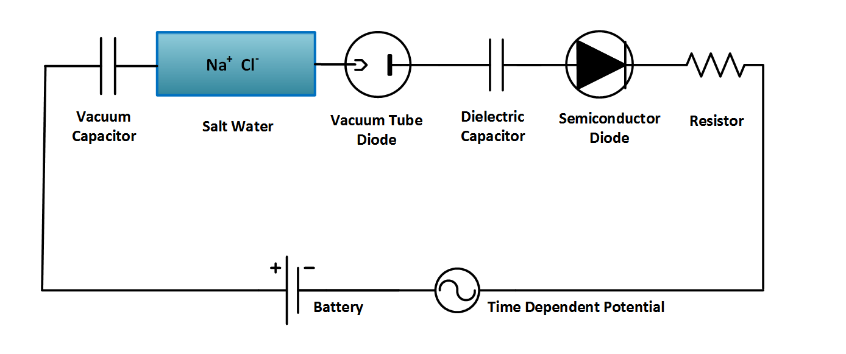
but Conservation of Current is EXACT and UNIVERSAL No matter what ‘charge’ carries the current! Discussed in Detail in http://arxiv.org/abs/1502.07251
‘Charge’ is an Abstraction
with different Physics in different systems
Ag AgCl
Ag AgCl
D = permittivity × E

Slide 18
but Conservation of Current is EXACT and UNIVERSAL No matter what ‘charge’ carries the current!
‘Charge’ is an Abstraction
with different Physics in different systems

Slide 20
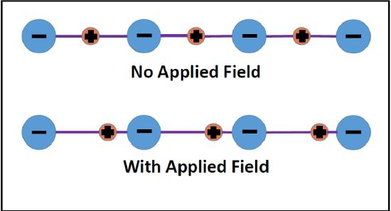
Electrodynamics and Ions in Chemistry
Applied Electric Field ZERO
Applied Electric Field NOT ZERO

Slide 21
Law of Mass Action
is how chemists have described chemicals,
not flows
k is constant
[ A] means the activity or approximately the concentration of species A, i.e., the number density of A

Slide 22
“ … incomplete truths learned on the way
may become ingrained and taken as the whole truth….… what is true and what is only sometimes true will become confused.”
Richard Feynman
from p.15-61 “The Feynman: Lectures on Physics, Mainly Electromagnetism and Matter. Vol. 2” 1963, New York: Addison-Wesley Publishing Co., also at available on line

Slide 23
Law of Mass Action
is about Conservation of Mass and Matter It is not about conservation of charge
[X] means the concentration, really activity of species Z, i.e., concentration is the number density

Slide 24
[X] means the concentration, really activity of species Z, i.e., concentration is the number density

Slide 25
Kirchoff Current Law and Maxwell Equations are nearly the same thing
Bhat & Osting (2011). IEEE Trans Antennas and Propagation 59: 3772-3778
Heras (2007) American Journal of Physics 75: 652-657
Heras (2011) American Journal of Physics 79: 409
Itzykson & Zuber Quantum Field Theory (1990) p. 10

Slide 26
‘Current-in’ does not automatically equal ‘Current-out’
in Rate Models
if rate constants are independent and Currents are Uncorrelated

Slide 27
Electricity is Different
Correlation
between currents is in fact
ALWAYS
0.999 999 999 999 999 999
because
Continuity of Current is Exact
Kirchoff Continuity of Current Law including displacement current
is another form of Maxwell’s Equations Heras, J.A.: Am J Phys 75: 652 (2007); Eur J Phys 30: 845 (2009); Am J Ph79: 409 (2011)

Slide 28
Engineering
is about
Signal Flow
not chemicals

Slide 29
How can this be?
Chemistry is about Chemicals
not signals

Slide 30
Maxwell’s Equations
Kirchoff’s Current Law
compute
Signals from Conservation of Charge and Continuity of Current, including displacement current

Slide 31
Parameterization is not Possible
under more than one condition
Rate constants chosen at one boundary charge or one potential cannot work for different charges or potentials
Currents in Rate Models are Independent of Charge and Potential
but
in the real world
Currents depend on Charge and Potential

Slide 32
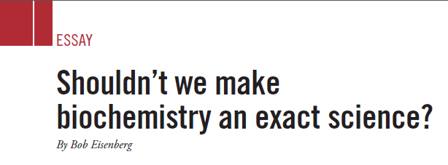

Cause of Frustration
Biochemical Models are Rarely TRANSFERRABLE Do Not Fit Data even approximately in more than one solution*
ASBMB Today (2014) 13:36-38
extended in http://arxiv.org/abs/1409.0243
Title chosen by Editor Charlie Brenner
Editors: Charlie Brenner, Angela Hopp American Society for Biochemistry and Molecular Biology
*i.e., in more than one concentration or type of salt, like Na⁺Cl⁻ or K⁺Cl ⁻ Note: Biology occurs in different solutions from those used in most measurements

Slide 34
Physical Chemists are Frustrated by Real Solutions

Slide 35
All of Biology occurs in Salt Solutions
of definite composition and concentration
and that matters!
Salt Water is the Liquid of Life
Pure H₂O is toxic to cells and molecules!
Salt Water is a Complex Fluid
Main Ions are Hard Spheres, close enough
Sodium Na⁺ Potassium K⁺ Calcium Ca²⁺ Chloride Cl⁻
K⁺
Na⁺
Ca⁺⁺
Cl⁻
3 Å

Slide 36
History of Derivations of Law of Mass Action
“Sometimes it is necessary to put a veil on the past, For the Sake of the Future”
Henry Clay, the Essential American
p. 375 D.S. & J.T. Heidler

Slide 37
Central Result of Physical Chemistry
Ions in a solution are a Highly Compressible Plasma
although the Solution is Incompressible
Free energy of an ionic solution is mostly determined by the Number density of the ions. Density varies from 10⁻¹¹ to 10¹M in typical biological system of proteins, nucleic acids, and channels.
Learned from Doug Henderson, J.-P. Hansen, Stuart Rice, among others…Thanks!

Slide 38
Electrolytes are Complex Fluids
Treating a Complex Fluid as if it were a Simple Fluid will produce Elusive Results

Slide 39
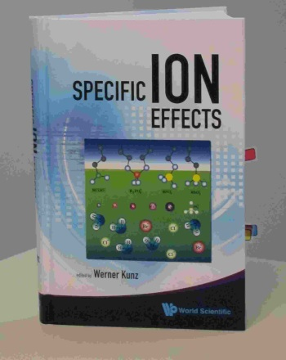
It is not surprising that Inconsistent Treatments of ionic solutions have been so Unsuccessful
despite more than a century of work by fine scientists and mathematicians
Werner Kunz:
“It is still a fact that over the last decades, it was easier to fly to the moon than to describe the free energy of even the simplest salt solutions beyond a concentration of 0.1M or so.”
Kunz, W. "Specific Ion Effects"
World Scientific Singapore, 2009; p 11.

Slide 40

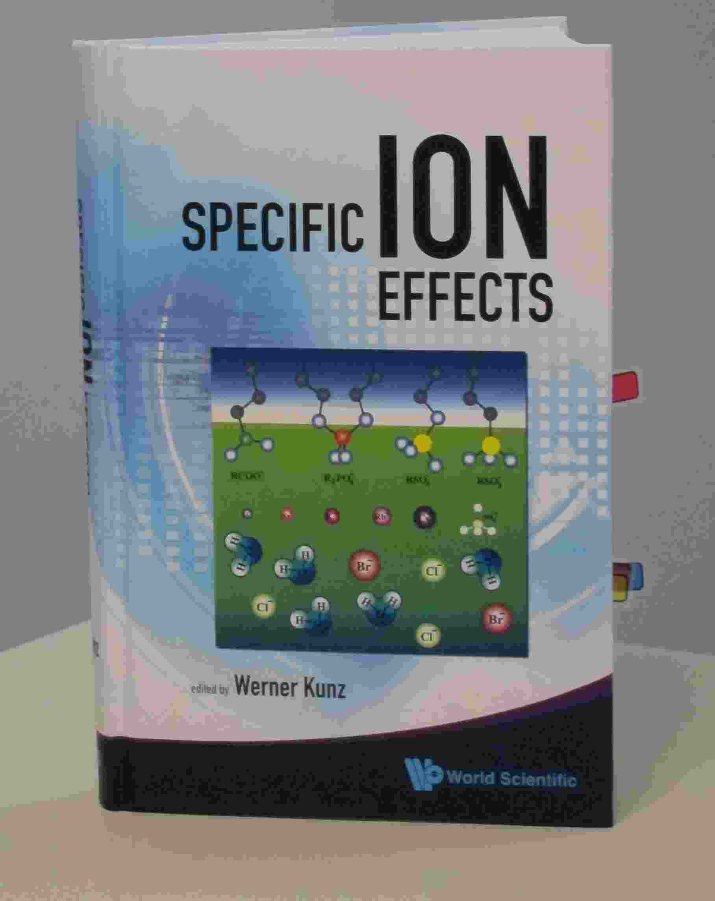
Werner Kunz
“It is still a fact that over the last decades, it was easier to fly to the moon than to describe the free energy of even the simplest salt solutions beyond a concentration of 0.1M or so.”
Kunz, W. "Specific Ion Effects"
World Scientific Singapore, 2009; p 11.

Slide 41
The classical text of Robinson and Stokes (not otherwise noted for its emotional content) gives a glimpse of these feelings when it says “In regard to concentrated solutions, many workers adopt a counsel of despair, confining their interest to concentrations below about 0.02 M, ... ” p. 302 Electrolyte Solutions (1959) Butterworths , also Dover (2002)

Slide 42
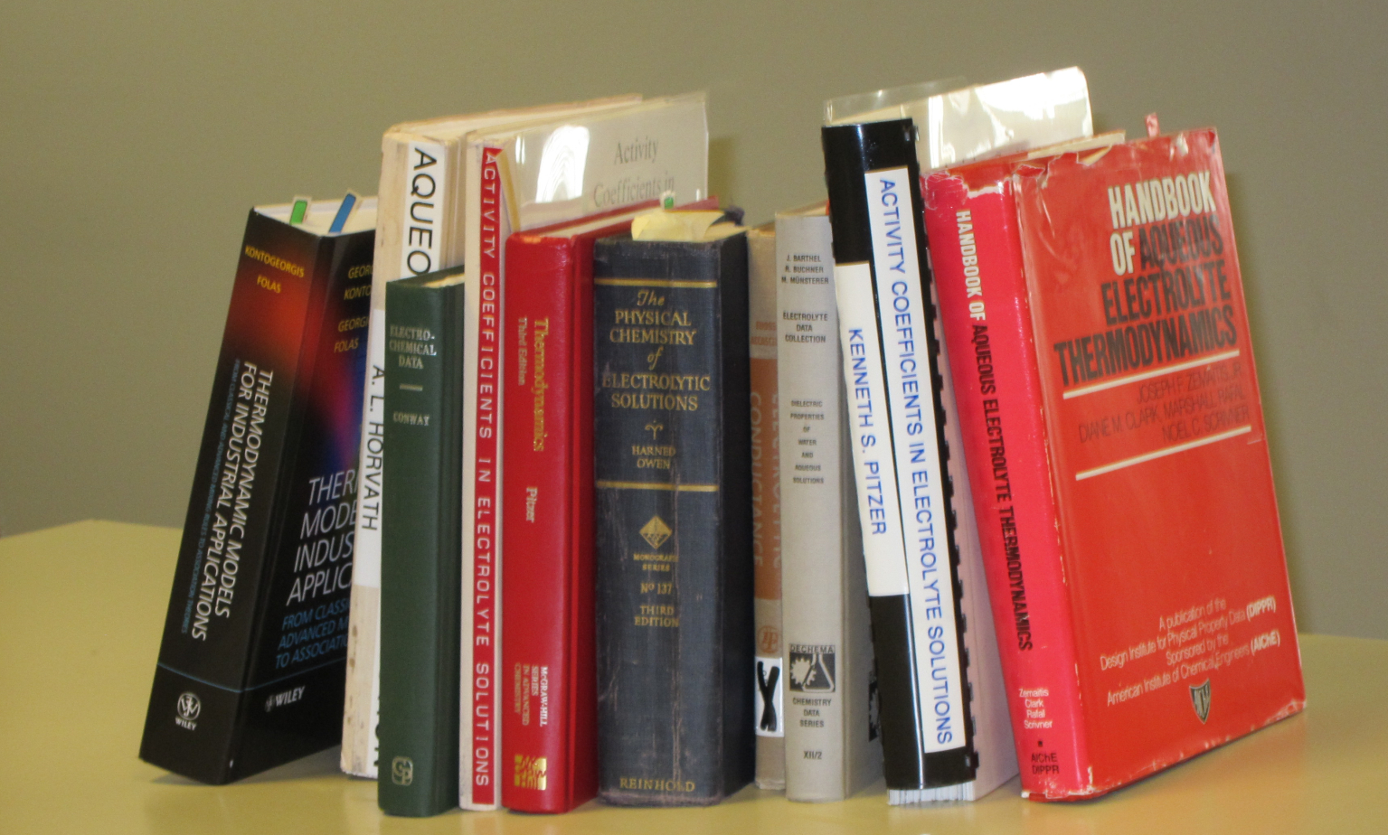
Good Data

Slide 43
It is difficult to even define in a unique way Properties of One Ion when
Everything Interacts
with Everything
Tremendous Opportunity for Applied Mathematics

Slide 44

Electrolytes are Complex Fluids
After 690 pages and 2604 references, properties of SINGLE Ions are Elusive* because Every Ion Interacts with Everything
*’elusive’ is in the authors’ choice in the title but emphasis is added
Hünenberger & Reif (2011) “Single-Ion Solvation … Approaches to Elusive* Thermodynamic Quantities”

Slide 45
Ions in Water are the Liquid of Life
They are not ideal solutions
Everything Interacts
with Everything
For Modelers and Mathematicians
Tremendous Opportunity for Applied Mathematics
because
‘law’ of mass action assumes nothing interacts Chun Liu’s Energetic Variational Principle
EnVarA

Slide 46
Good Data
Compilations of Specific Ion Effect
>139,175 Data Points [Sept 2011] on-line IVC-SEP Tech Univ of Denmark http://www.cere.dtu.dk/Expertise/Data_Bank.aspx
2. Kontogeorgis, G. and G. Folas, 2009: Models for Electrolyte Systems. Thermodynamic John Wiley & Sons, Ltd. 461-523.
3. Zemaitis, J.F., Jr., D.M. Clark, M. Rafal, and N.C. Scrivner, 1986, Handbook of Aqueous Electrolyte Thermodynamics.
American Institute of Chemical Engineers
4. Pytkowicz, R.M., 1979, Activity Coefficients in Electrolyte Solutions. Vol. 1. Boca Raton FL USA: CRC. 288.

Slide 47
Everything Interacts
Mathematics of Chemistry
must deal
Naturally
with Interactions
‘Law of Mass Action’ assumes nothing interacts
So this is a great opportunity for new mathematics and applications!

Slide 48
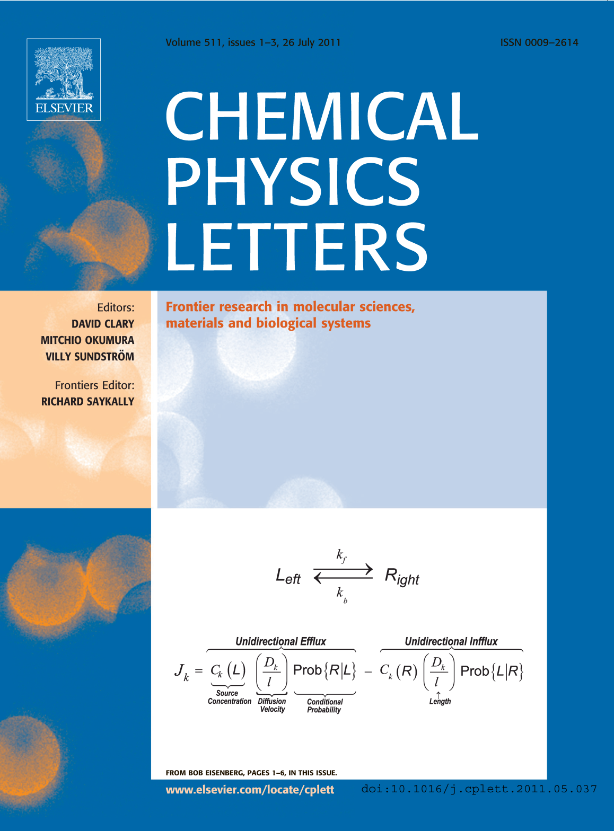
Mathematics of Interactions in Complex Fluids
‘Law’ of Mass Action including Interactions
Variational Approach
EnVarA
Conservative
Dissipative
From Bob Eisenberg p. 1-6, in this issue

Slide 49
Shielding is a defining property of Complex Fluids
It is VERY hard to Simulate at Equilibrium
and (in my opinion)
IMPOSSIBLE to Simulate in nonequilibrium
Like Batteries or Nerve Fibers
because flows involve Far Field (macroscopic) boundaries

Slide 50
Main Qualitative Result
Shielding Dominates
Electric Properties of Channels, Proteins, as it does Ionic Solutions
Shielding is ignored in traditional treatments
of Ion Channels and of Active Sites of proteins
Rate Constants Depend on Shielding
and so
Rate Constants Depend on Concentration and Charge

Slide 51
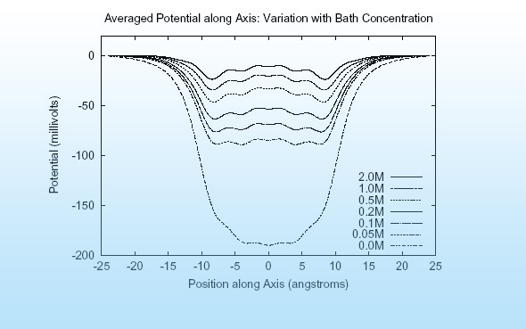
Main Qualitative Result Shielding in Gramicidin
Hollerbach & Eisenberg

Slide 52
Reconciling
Mass Action
and
Maxwell/Kirchoff
will no doubt be a
Long Journey

Slide 53
“ … incomplete truths learned on the way
may become ingrained and taken as the whole truth….… what is true and what is only sometimes true will become confused.”
Richard Feynman
from p.15-61 “The Feynman: Lectures on Physics, Mainly Electromagnetism and Matter. Vol. 2” 1963, New York: Addison-Wesley Publishing Co., also at available on line

Slide 54
History of Derivations of Law of Mass Action
“Sometimes it is necessary to put a veil on the past, For the Sake of the Future”
Henry Clay, the Essential American
p. 375 D.S. & J.T. Heidler

Slide 55
“Journey of a thousand miles starts with a single step”
in the right direction,
I beg to add to this Chinese saying

Slide 56
As a Chicago Surgeon put it
You better head in the right direction,
if you want to get anywhere

Slide 57
That direction needs to include the Electric Field calculated and calibrated, global and local, if the journey is ever to end, in my view.

Slide 58
Replacement of “Law of Mass Action” is Feasible for Ionic Solutions
using the All Spheres (primitive = implicit solvent model of ionic solutions) and Theory of Complex Fluids

Slide 59
Variational Approach
EnVarA
‘Law’ of Mass Action including Interactions
Conservative
Dissipative
From Bob Eisenberg p. 1-6, in this issue

Slide 60
Energetic Variational Approach allows
accurate computation of Flow and Interactions in Complex Fluids like Liquid Crystals
Classical theories and Molecular Dynamics have difficulties with flow, interactions, and complex fluids
Engineering needs Calibrated Theories and Simulations
Engineering Devices almost always use flow

Slide 61
Energetic Variational Approach EnVarA Chun Liu, Rolf Ryham, and Yunkyong Hyon
Mathematicians and Modelers: two different ‘partial’ variations
written in one framework, using a ‘pullback’ of the action integral
Shorthand for Euler Lagrange process
with respect to
Shorthand for Euler Lagrange process
with respect to
Action Integral, after pullback
Rayleigh Dissipation Function
Composite Variational Principle
Euler Lagrange Equations
Field Theory of Ionic Solutions: Liu, Ryham, Hyon, Eisenberg
Allows boundary conditions and flow Deals Consistently with Interactions of Components

Slide 62
Dissipation Principle Conservative Energy dissipates into Friction
Number Density
time
Permanent Charge of protein
Hard Sphere Terms
Thermal Energy
valence
proton charge
c_{i} number density; thermal energy; D_{i} diffusion coefficient; n negative; p positive; z_{i} valence; ε dielectric constant
Note that
with suitable boundary conditions

Slide 63
Energetic Variational Approach EnVarA
is defined by the Euler Lagrange Process,
as I understand the pure math from Craig Evans
which gives Equations like PNP
BUT
I leave it to you (all)
to argue/discuss with Craig about the purity of the process when two variations are involved

Slide 64
PNP (Poisson Nernst Planck) for Spheres
Non-equilibrium variational field theory EnVarA
Nernst Planck Diffusion Equation
for number density c_{n} of negative n ions; positive ions are analogous
Diffusion Coefficient
Thermal Energy
Coupling Parameters
Ion Radii
Number Densities
Poisson Equation
Dielectric Coefficient
valence
proton charge
Eisenberg, Hyon, and Liu
Permanent Charge of Protein

Slide 65
Semiconductor PNP Equations For Point Charges
Dielectric Coefficient
Poisson’s Equation
Permanent Charge of Protein
Valence
Proton charge
Cross sectional Area
Drift-diffusion & Continuity Equation
Number Densities
Flux
Diffusion Coefficient
Chemical Potential
Not in Semiconductor
valence
proton charge
Thermal Energy

Slide 66
All we have to do is Solve them! with Boundary Conditions defining Charge Carriers ions, holes, quasi-electrons Geometry

Slide 67
Solution* of PNP Equation
*MATHEMATICS
This solution was actually DERIVED by computing many conditional probability measures explicitly by repeated analytical integrations
Eisenberg, Klosek, & Schuss (1995) J. Chem. Phys. 102, 1767-1780 Eisenberg, B. (2000) in Biophysics Textbook On Line "Channels, Receptors, and Transporters" Eisenberg, B. (2011). Chemical Physics Letters 511: 1-6

Slide 68
Please do not be deceived by the eventual simplicity of Results. This took >2 years!
Solution was actually DERIVED with explicit formulae for probability measures from a Doubly Conditioned Stochastic Process involving Analytical Evaluation of Multidimensional Convolution Integrals
Eisenberg, Klosek, & Schuss (1995) J. Chem. Phys. 102, 1767-1780 Eisenberg, B. (2000) in Biophysics Textbook On Line "Channels, Receptors, Transporters" Eisenberg, B. (2011). Chemical Physics Letters 511: 1-6

Slide 69
All we have to do is Solve them! Don’t Despair Semiconductor Technology has Already Done That!

Slide 70
Semiconductor Devices
PNP equations describe many robust input output relations
Amplifier
Limiter
Switch
Multiplier
Logarithmic convertor
Exponential convertor
These are SOLUTIONS of PNP for different boundary conditions
with ONE SET of CONSTITUTIVE PARAMETERS PNP of POINTS is TRANSFERRABLE Analytical should be attempted using techniques of Weishi Liu University of Kansas Tai-Chia Lin National Taiwan University & Chun Liu PSU

Slide 71
The End
Any Questions?

